Slide 1
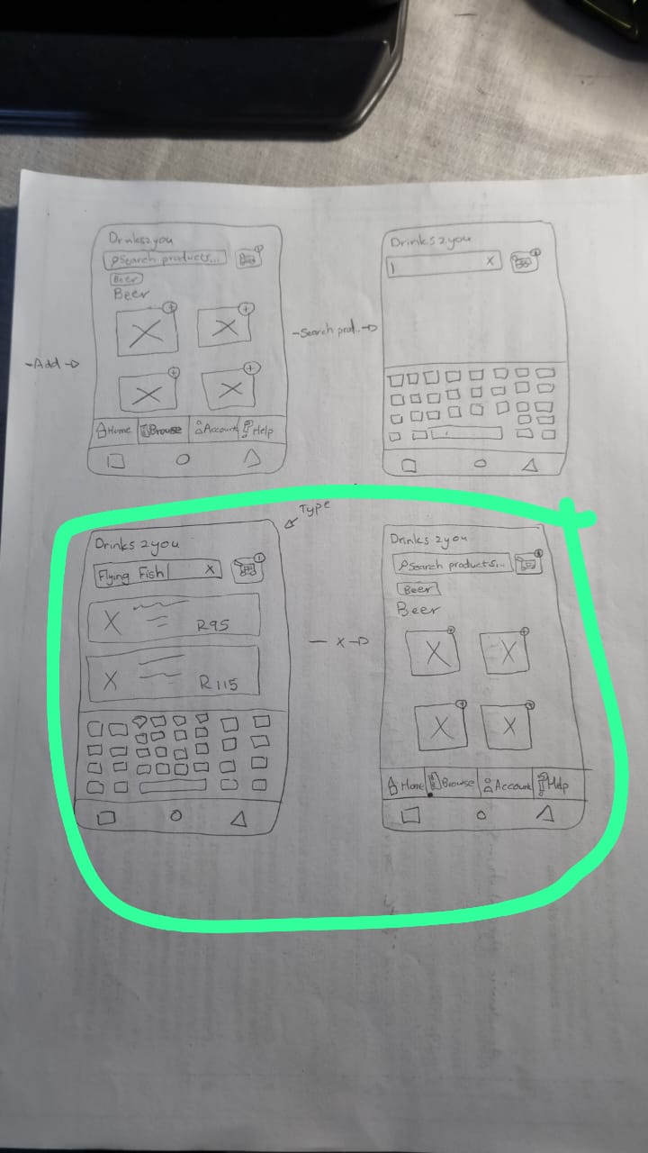
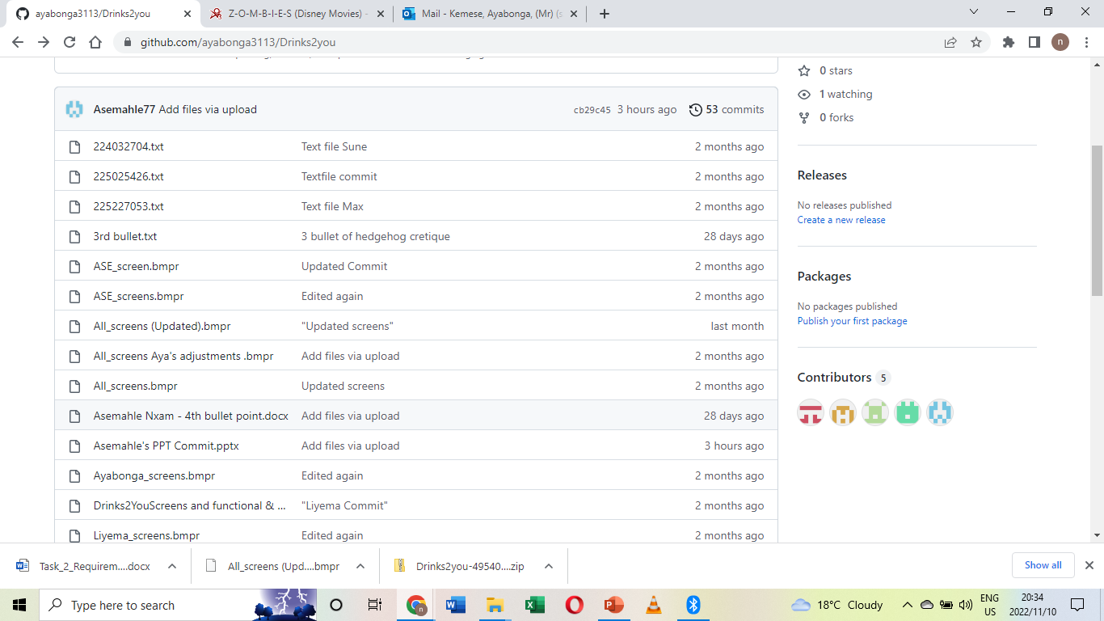
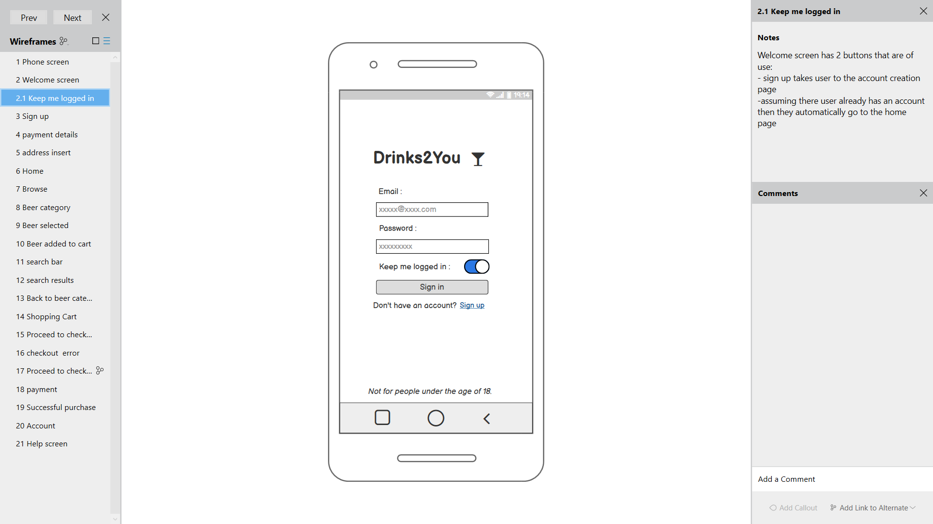
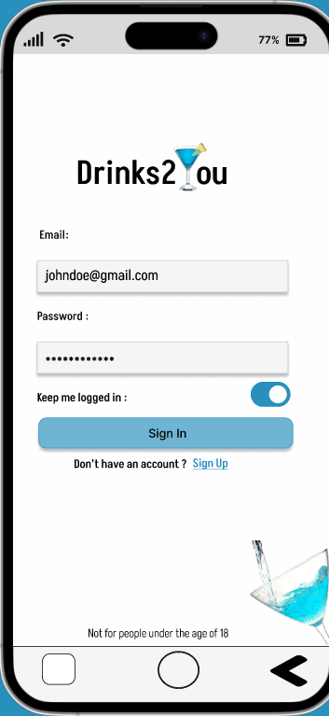
Slide 1
WEEK 1
Sketching
WEEK 2
collaboration
WEEK 3
Lo-Fi
Final
HI - Fi

Slide 2
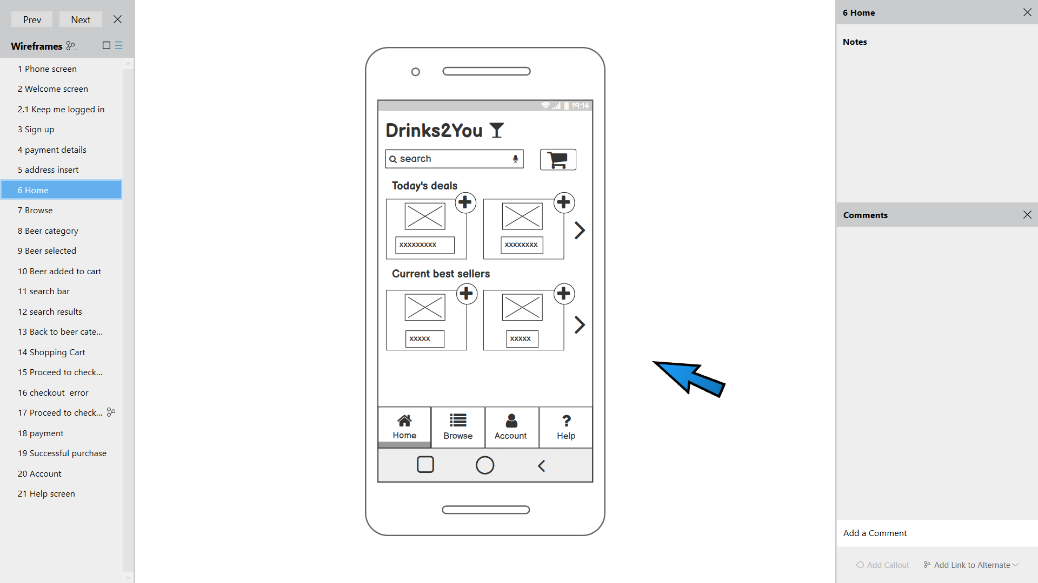
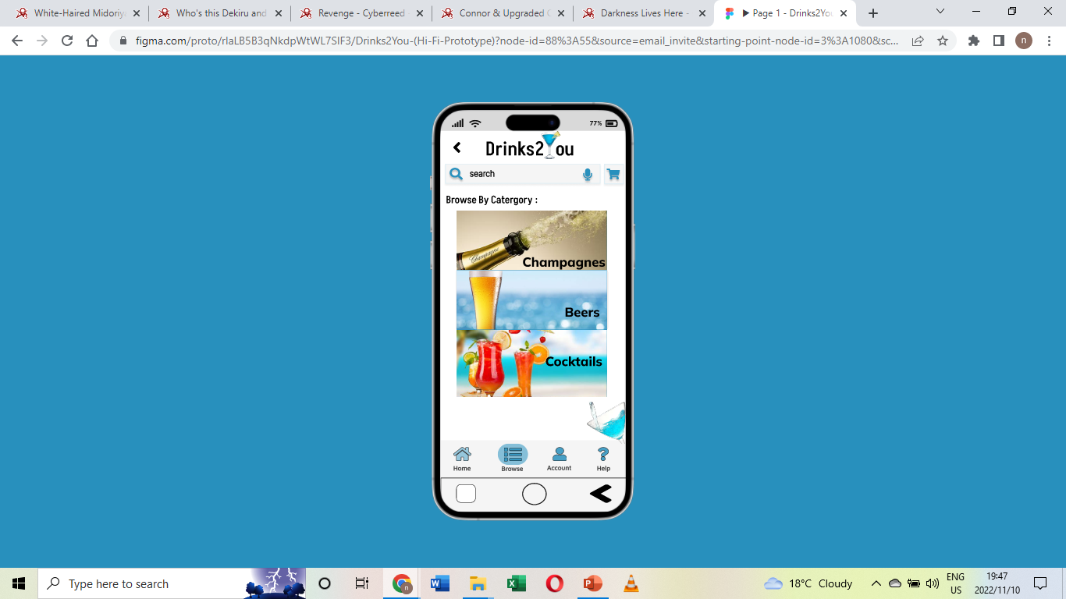
design choices
We created an accurate lo-fi with all the details and all necessary elements
Then reduces it to be more user friendly
Once the high fidelity was created we decided to go for a more summer time feel to the app while maintaining the minimalist design that modern day apps have

Slide 3
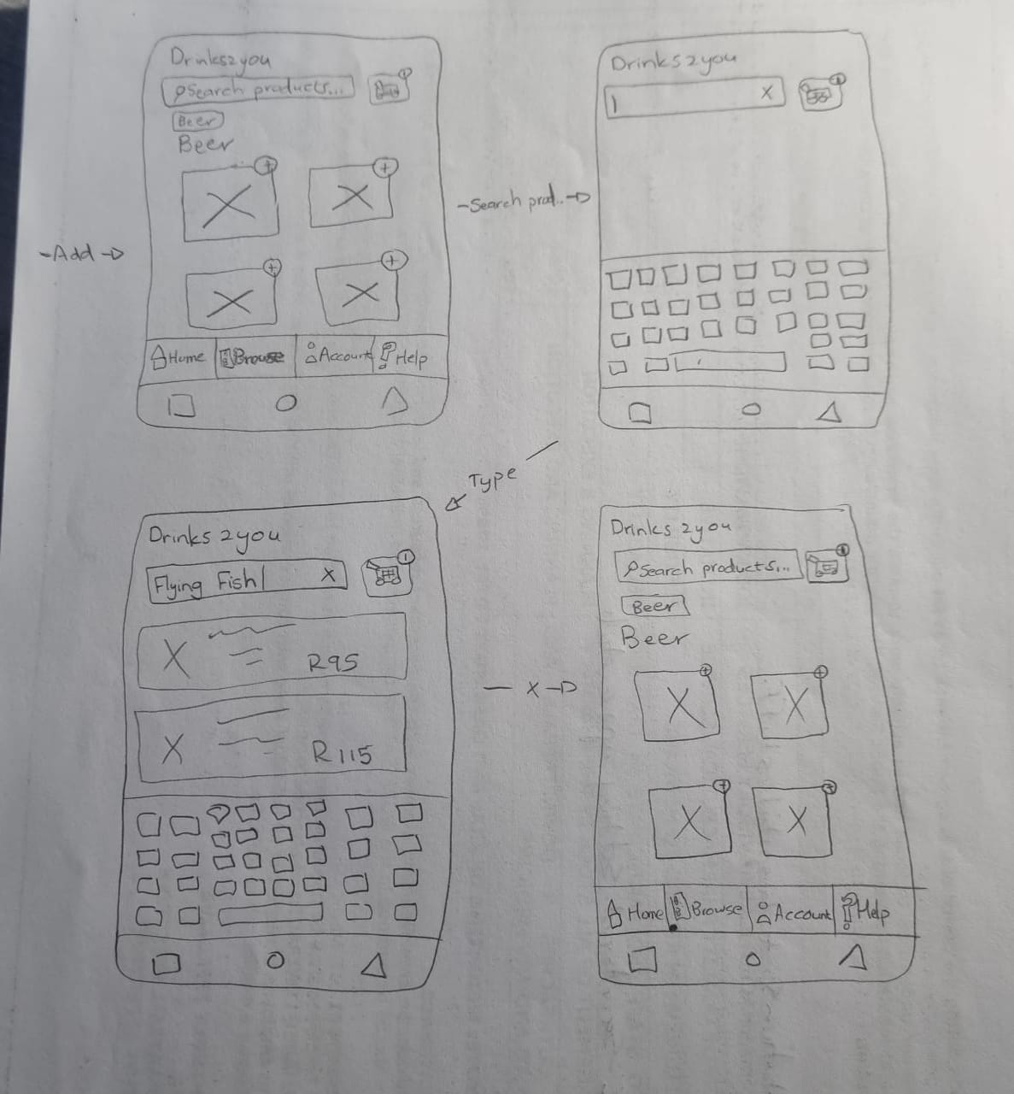
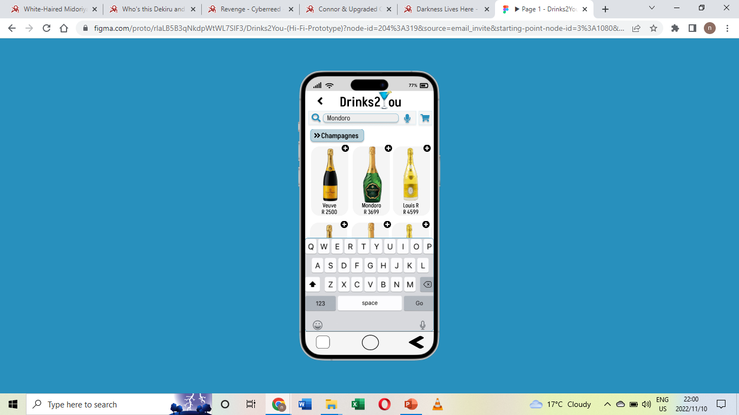
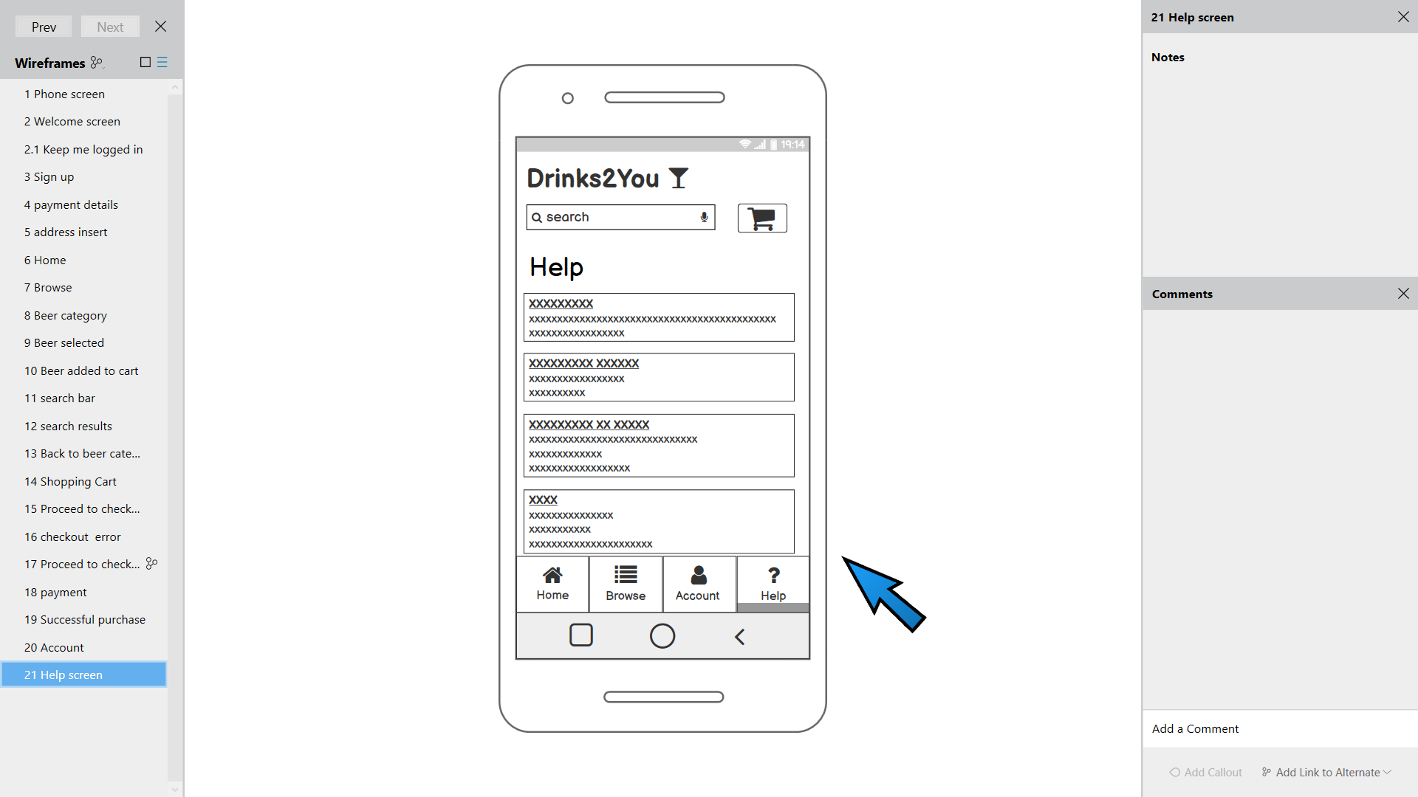
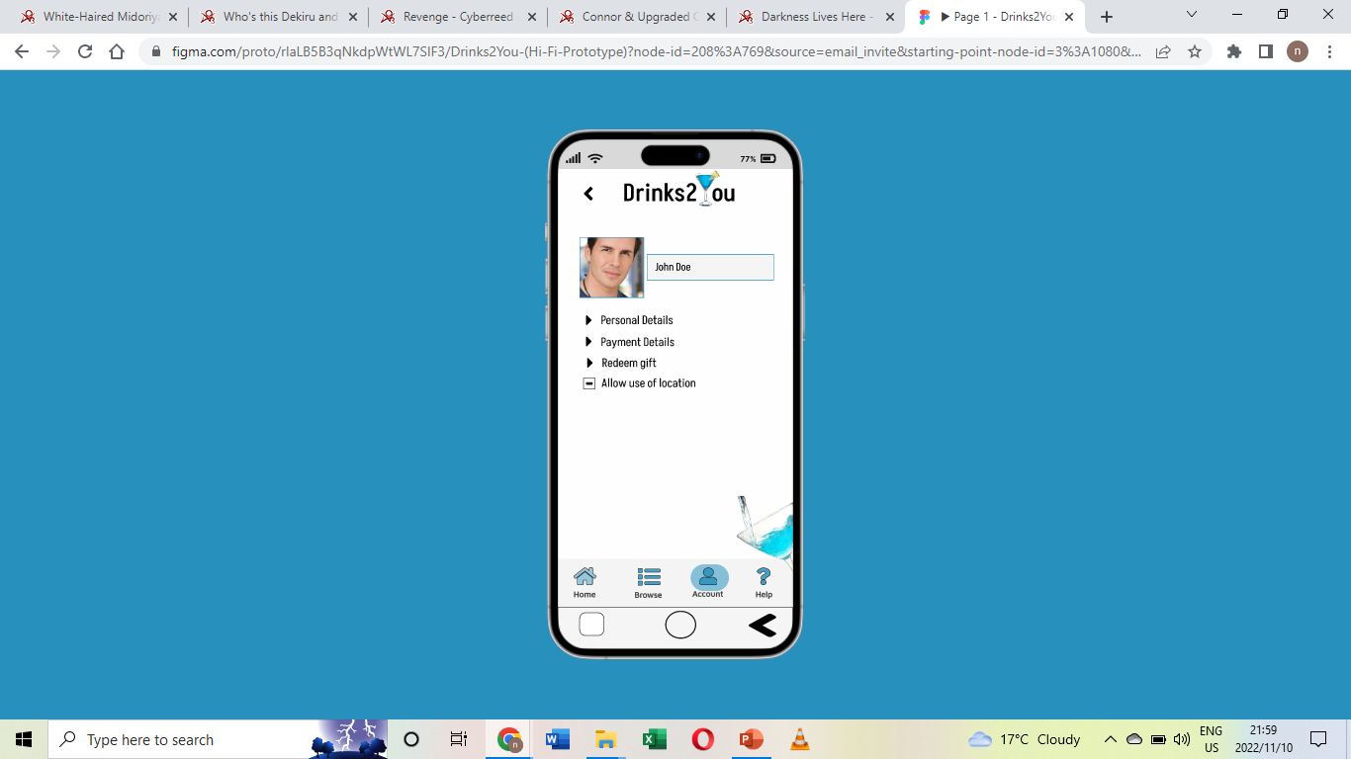
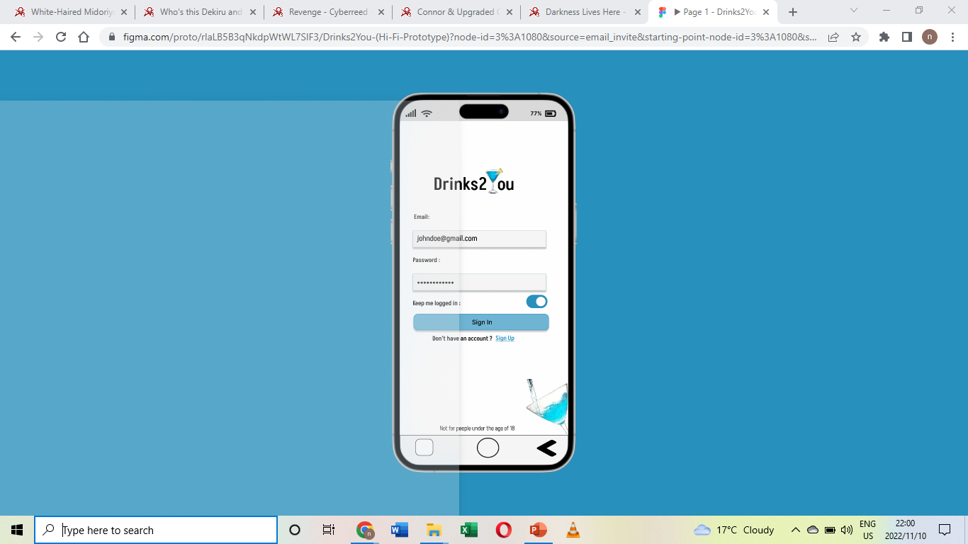
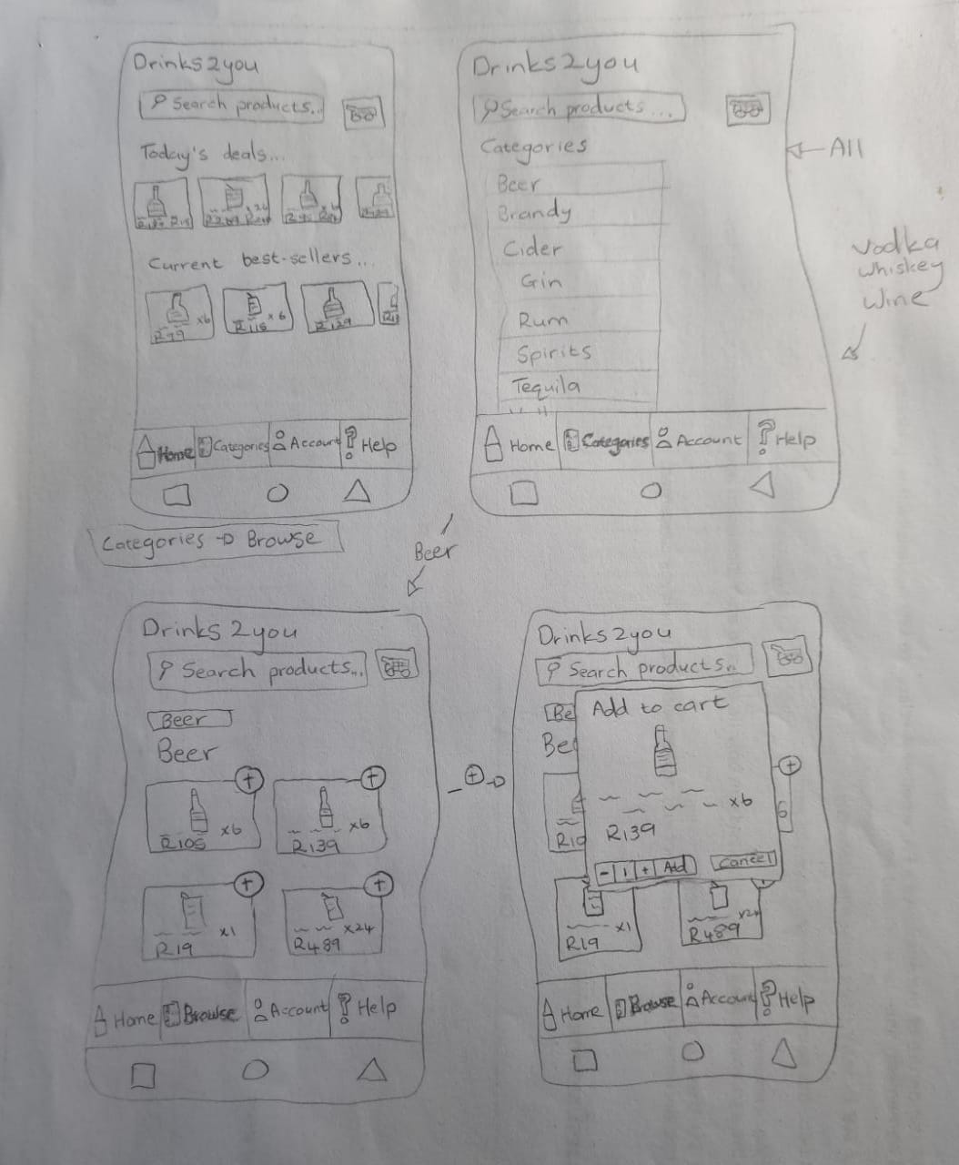
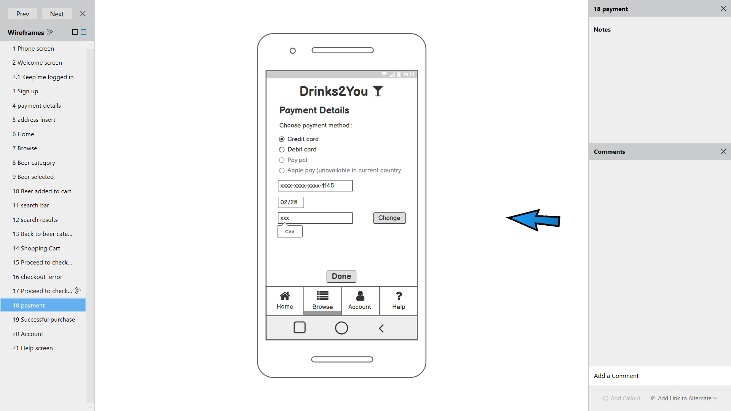
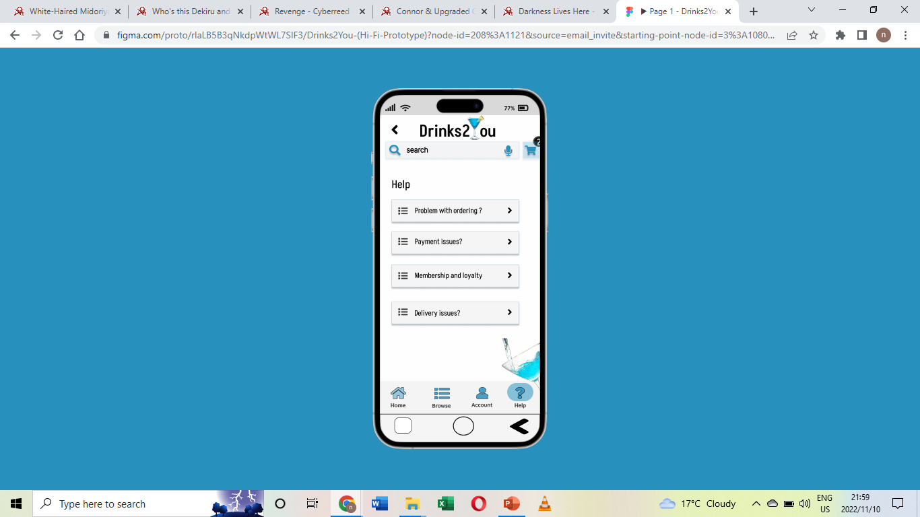
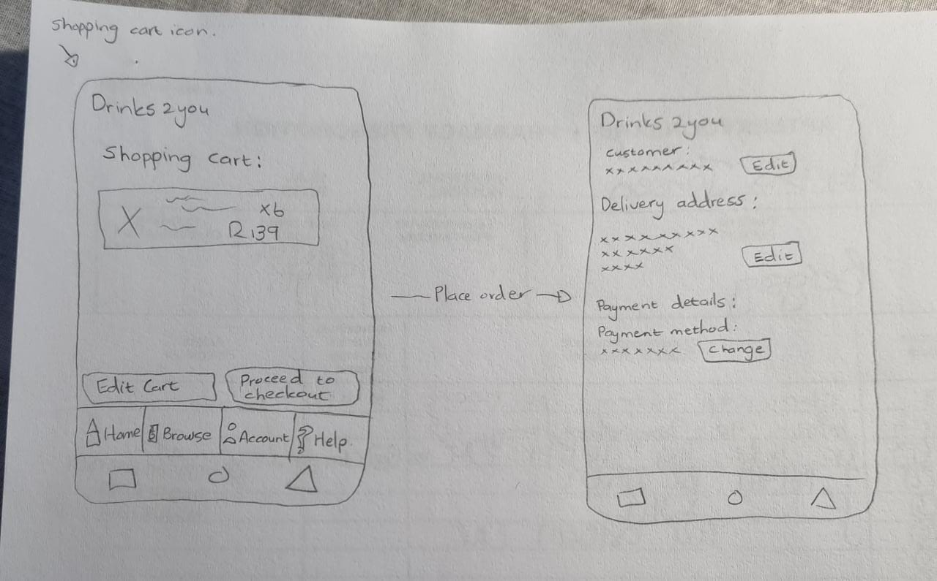
Tools used
Hand drawn
FIGMA
Balsamiq

Slide 4
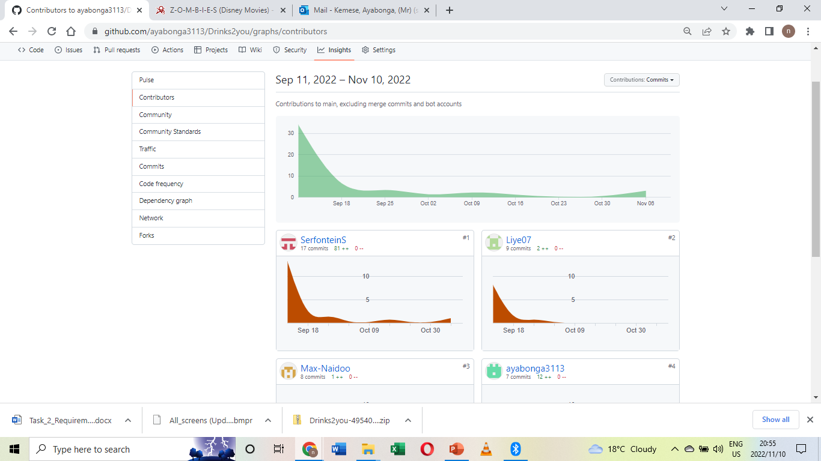
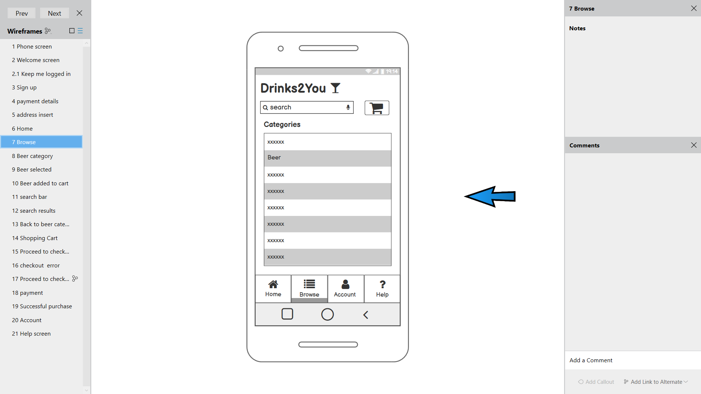
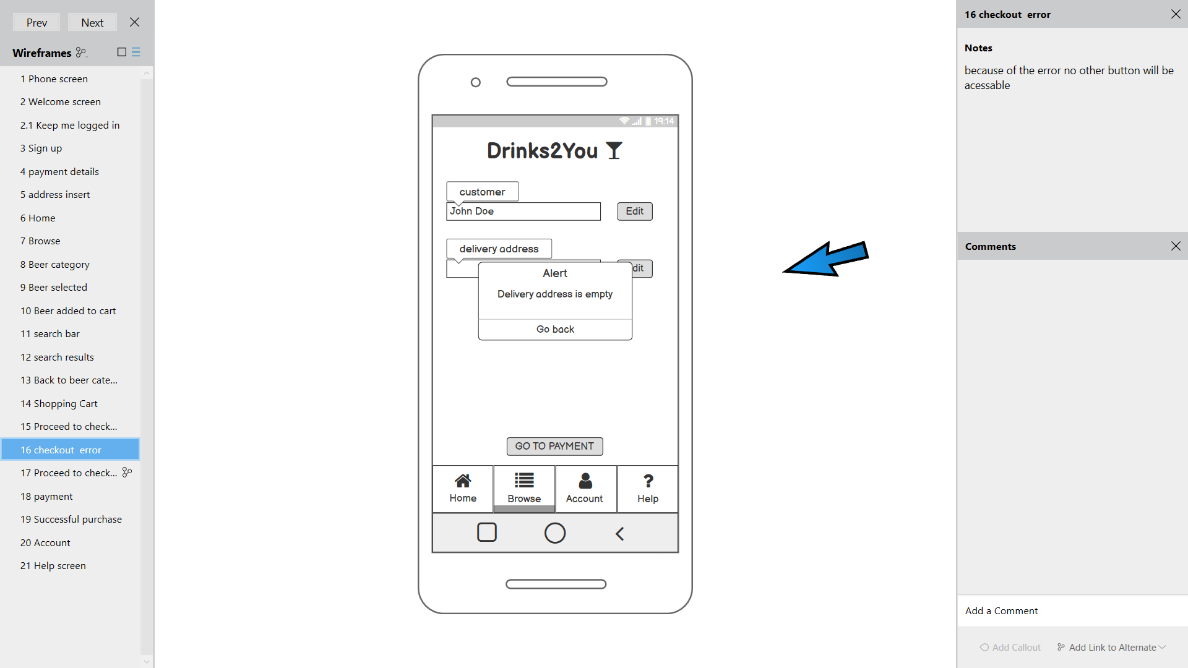

Reasons for success
Time spent
Trial and Error
When free time was available, we would work on the app insuring it was to the best of our skills
From Sept 11 to Nov 10
We went through multiple iterations of the lo – fi to ensure it was usable and user friendly
Attention to detail
When build the proto-type we included everything including error screens and detailed explanation
The teams collaboration
This app is a huge success thanks to the team I’ve work with. From nights spent stressing to deadlines met successfully none of this would have been possible without them

Slide 5
FIGMA prototype

